Slide 1
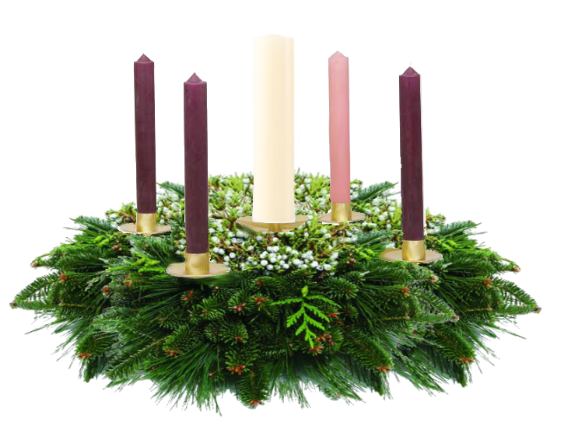
The 2008 Christmas Fund Advent Candle Liturgy

Slide 2
The Second Sunday in Advent
December 7th, 2008
The Christmas Fund’s health supplements bring peace of mind and spirit to many retired pastors, musicians, sextons and administrators.

Slide 3
You who bring good tidings to Jerusalem, lift up your voice with a shout, lift it up, do not be afraid; say to the towns of Judah, “Here is your God.” (Is 40:9b)
Comfort, comfort my people, says your God. Speak tenderly … (Is 40:1a)
Notes:
Reader 1:
You who bring good tidings to Jerusalem, lift up your voice with a shout, lift it up, do not be afraid; say to the towns of Judah, “Here is your God.”. . . (Is 40:9b)
Comfort, comfort my people, says your God. Speak tenderly . . . (Is 40:1a)

Slide 4
Last week we lit the Candle of Hope and lifted hopeful voices. (light first candle)
We remembered the long, wide and beautiful procession of those in many times and places, and even this sanctuary, who have shared hope.
Notes:
Lighter:
Last week we lit the Candle of Hope and lifted hopeful voices.
We remembered the long, wide and beautiful procession of those in many times and places, and even this sanctuary, who have shared hope.

Slide 5
The Candle of Hope
The Christmas fund offers hope through pension supplements to active and retired clergy and active and retired lay employees who have brought good tidings to churches throughout the United Church of Christ.
Notes:
Lighter:
(Lights the First Candle)

Slide 6
This is the Candle of Peace. There is great need for peace in families, communities and churches, and a deep longing for reconciliation within nations and between nations.
God does not only comfort us, but also commands us to be comforters, to lift up voices in a fearless shout and a prayer for peace.
Notes:
Reader 2:
This is the Candle of Peace.
There is great need for peace in families, communities and churches, and a deep longing for reconciliation within nations and between nations.
God does not only comfort us, but also commands us to be comforters, to lift up voices in a fearless shout and a prayer for peace.

Slide 7
The Candle of Peace
The Christmas Fund’s health supplements bring peace of mind and spirit to many retired pastors, musicians, sextons and administrators.
Notes:
Lighter:
(Lights the second candle)

Slide 8
Every time a word of peace is shouted or whispered , arguments falter, bitterness is eased, treaties are tried. Emmanuel is the one who stills the storm and, also, the one who asks us to walk on the water. We pause now to pray in our hearts for the places where peace is needed. We lift them up.
(Silence. People may softly name personal conflicts, community or global strife, the names of those in military service.)
Notes:
Reader 1:
Every time a word of peace is shouted or whispered, arguments falter, bitterness is eased, treaties are tried. Emmanuel is the one who stills the storm and, also, the one who asks us to walk on the water.
We pause now to pray in our hearts for the places where peace is needed. We lift them up.
(Silence. In some churches people may softly name personal conflicts, community or global strife, the names of those in military service.)

Slide 9
(Let us pray)
Emmanuel, Prince of Peace, we give you thanks for ministries of reconciliation and grace in our church. Strengthen all voices which call for peace and comfort your people - families, schools, communities, nations, and even these your children who in a season of hurry and worry need peace of mind and spirit.
Amen
Notes:
Reader 2:
(Let us pray)
Emmanuel, Prince of Peace, we give you thanks for ministries of reconciliation and grace in our church.
Strengthen all voices which call for peace and comfort your people - families, schools, communities, nations, and even these your children who in a season of hurry and worry need peace of mind and spirit.
Amen

Slide 10
Unison Prayer
Lift up your voice with a shout, lift it up, do not be afraid … (Is40: 9b NIV)
Emmanuel, Prince of Peace, we thank you that we are in this peaceful place in a month when much is chaotic. We thank you for our church ___ and for those who shape its ministries – pastor, sexton, musician, educator, administrator.
Help us to lift up our voices in the world, so that reconciliation and grace may begin with our tranquil spirits and, from there, lift and light up family, school, community and your precious world.
Amen.
Notes:
Reader 1:
(Second Sunday in Advent Unison Prayer Option)
Lift up your voice with a shout, lift it up, do not be afraid … (Is 40:9b NIV)
Emmanuel, Prince of Peace, we thank you that we are in this peaceful place in a month when much is chaotic. We thank you for our church , _______, and for those who shape its ministries – pastor, sexton, musician, educator, administrator.
Help us to lift up our voices in the world, so that reconciliation and grace may begin with our tranquil spirits and, from there, lift and light up family, school, community and your precious world.
Amen.

