Slide 1
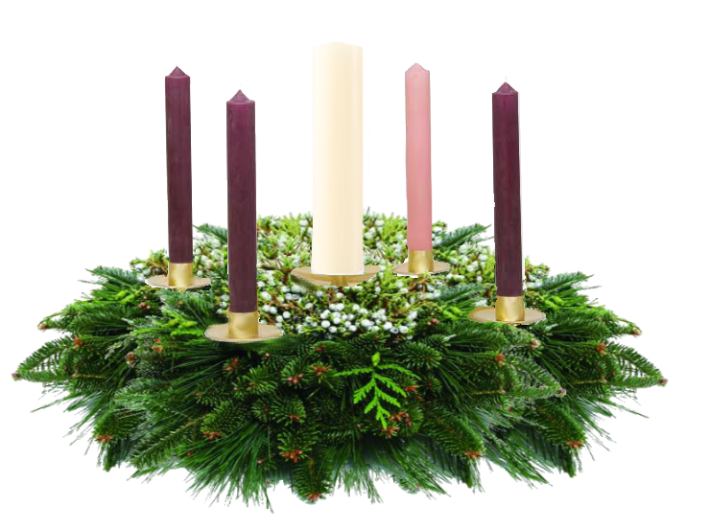
The 2008 Christmas Fund Advent Candle Liturgy

Slide 2
The Third Sunday in Advent
December 14th, 2008
The Christmas Fund sends Christmas gift checks that bring joy to retired clergy and lay workers – this year more than 30 of whom are one hundred years old or older.

Slide 3
Lift up your voice with a shout, lift it up, do not be afraid . .. (Is 40:9b)
Our mouths were filled with laughter and our tongues with songs of joy. (Psalm 126:2a NIV)
Notes:
Reader 1:
Lift up your voice with a shout, lift it up, do not be afraid . .. (Is 40:9b)
Our mouths were filled with laughter and our tongues with songs of joy... (Psalm 126:2a NIV)

Slide 4
Last week we lit the Candle of Hope and the Candle of Peace, lifting our voices in a promise of hope and a prayer for peace.
We celebrate the Messiah’s birth and the angel words – Peace on Earth.
Notes:
Reader 2:
Last week we lit the Candle of Hope and the Candle of Peace, lifting our voices in a promise of hope and a prayer for peace. (light two candles)
We celebrate the Messiah’s birth and the angel words – Peace on Earth.

Slide 5
The Candle of Hope and the Candle of Peace
The Christmas fund offers hope through pension supplements to active and retired clergy and active and retired lay employees who have brought good tidings to churches throughout the United Church of Christ.
Notes:
Lighter:
(Lights the First Candle and Second Candle)

Slide 6
This the Candle of Joy.
Look around at this season in this place – not the frantic bustle of consumerism, but young and old singing a carol together.
A card sent to a lonely person, the story told in pageant or cantata or live nativity, the generosity of white gifts, mitten trees, Christmas boxes, the welcome of a stranger to the manger.
In these ways we lift up our voices in a fearless shout and a song of joy.
Notes:
Lighter:
This the Candle of Joy.
Look around at this season in this place – not the frantic bustle of consumerism, but young and old singing a carol together.
A card sent to a lonely person, the story told in pageant or cantata or live nativity, the generosity of white gifts, mitten trees, Christmas boxes, the welcome of a stranger to the manger.
In these ways we lift up our voices in a fearless shout and a song of joy.

Slide 7
The Candle of Joy
The Christmas Fund sends Christmas gift checks that bring joy to retired clergy and lay workers – this year more than 30 of whom are one hundred years old or older.
Notes:
Lighter:
(Lights the Third Candle)

Slide 8
We enjoy Christ’s birth, as it has been enjoyed by the great procession of God’s people – young and old, wise and wondering, needy and fortunate. We feel ourselves a part of that truly cosmic celebration. We pause now for just a moment to identify one true source of rejoicing in our lives this year, even if it is a tiny smile on the edge of hard times. We lift these up.
(Instead of silence, soft bars of “Joy to the World” or in a church which doesn’t use carols, “Joyful, Joyful, we Adore You.” In some churches, people may wish to speak or whisper the things that bring joy.)
Notes:
Reader 1:
We enjoy Christ’s birth, as it has been enjoyed by the great procession of God’s people – young and old, wise and wondering, needy and fortunate. We feel ourselves a part of that truly cosmic celebration. We pause now for just a moment to identify one true source of rejoicing in our lives this year, even if it is a tiny smile on the edge of hard times. We lift these up.
(Instead of silence, soft bars of “Joy to the World” or in a church which doesn’t use carols, “Joyful, Joyful, we Adore You.” In some churches, people may wish to speak or whisper the things that bring joy.)

Slide 9
(Let us pray)
Emmanuel, God-with-us, when the words of joy around us sound frivolous, forced or false, lift up our voices on behalf of sources of joy which are lasting and true.
Help us to find the lost, the lonely, the poor, the hungry, the wandering – those who are falling behind in the procession of life and … first smile, then reach, then lift them up.
Amen
Notes:
Reader 2:
(Let us pray)
Emmanuel, God-with-us, when the words of joy around us sound frivolous, forced or false, lift up our voices on behalf of sources of joy which are lasting and true. Help us to find the lost, the lonely, the poor, the hungry, the wandering – those who are falling behind in the procession of life and … first smile, then reach, then lift them up. Amen

Slide 10
Unison Prayer
Lift up your voice with a shout, lift it up, do not be afraid … (Is40: 9b NIV)
Emmanuel, shining One, light candles of joy in the hearts of those who need you most this year – the refugee, the child of a new divorce, the unemployed, the weary nurse, the very young and the very old.
We ask your tender blessing for those retired pastors and lay church workers who have lifted up the story and now need your spark of joy.
Amen.
Notes:
Third Sunday in Advent Unison Prayer Option:
Lift up your voice with a shout, lift it up, do not be afraid … (Is40: 9b NIV)
Emmanuel, shining One, light candles of joy in the hearts of those who need you most this year – the refugee, the child of a new divorce, the unemployed, the weary nurse, the very young and the very old. We ask your tender blessing for those retired pastors and lay church workers who have lifted up the story and now need your spark of joy. Amen.

