Slide 1
2011 Christmas Fund
Advent Candle Liturgy
Christmas Eve December 24, 2011

Slide 2
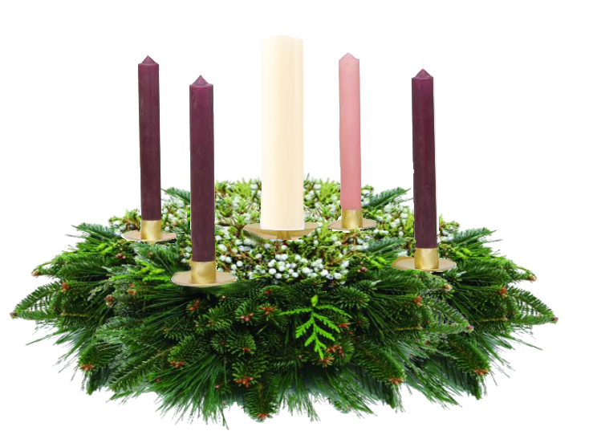
We gather around our Advent wreath this evening for a final time. The circle of light is completed because in its center is the shining light of Bethlehem.
Notes:
Reader 1:
We gather around our Advent wreath this morning for a final time. The circle of light is completed because in its center is the shining light of Bethlehem.

Slide 3
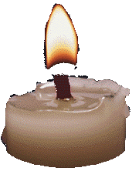
Hope is the first candle. Hope shines – the hope of long ago prophets and each one of us for the light of the world.
Light the candle of Hope
Notes:
Reader 2:
hope is the first candle. Hope shines – the hope of long ago prophets and each one of us for the light of the world.
Lighter:
(Light the first candle)

Slide 4
Peace is the second candle. Peace shines in angels who bent over the earth to sing “Glory to God and Peace on Earth, “ and in every small human effort to make peace in home or community, nation and world.
Light the Candle of Peace.
Notes:
Reader 1:
Peace is the second candle. Peace shines in angels who bent over the earth to sing “Glory to God and Peace on Earth, “ and in every small human effort to make peace in home or community, nation and world.
Lighter:
(Light the second candle)

Slide 5
Joy is the third candle. Joy shines in symbols of pine bough and crèche, of carols and gifts, in the faces gathered in our sanctuary and the faces of all God’s children as far away as the Magi’s homelands.
Light the Candle
of Joy.
Notes:
Reader 2:
Joy is the third candle. Joy shines in symbols of pine bough an crèche, of carols and gifts, in the faces gathered in our sanctuary and the faces of all God’s children as far away as the magi’s homelands.
Lighter:
(Light the third candle)

Slide 6
Love is the fourth candle. Love shines the love that came down in the Bethlehem manger and the love that names everywhere the city of David and love shines every one of us innkeepers with a manger in our hearts.
Light the Candle
of Love.
Notes:
Reader 1:
Love is the fourth candle. Love shines, the love that came down in the Bethlehem manger and the love that names everywhere the city of David, and love shines every one of us innkeepers with a manger in our hearts.
Lighter:
(Light the fourth candle)

Slide 7
Tonight we light the Christ Candle. Christ shines and we see God’s face. We read by this light the old stories of good tidings and find by this light on our journey into the New Year so we can share those tidings with all God’s children.
Notes:
Reader 2:
Today we light the Christ Candle. Christ shines and we see God’s face. We read by this light the old stories of good tidings and find by this light our journey into the New Year so we can share those tidings with all God’s children.

Slide 8
Light the Christ Candle
Notes:
Lighter:
(Light the Christ Candle)
.

Slide 9
Let us pray…
Emmanuel, God-with-us, we give you thanks for the Star shining on us this night and the possibility of lighting our small candles at its fire.
Because your face shines upon us, we promise to reflect hope and peace, joy and love on all faces and in all places, and live with Christ, the Light of the world, in the center of our lives. Amen.
Notes:
Lighter:
Let us pray…
Emmanuel, God-with-us, we give you thanks for the Star shining on us this night and the possibility of lighting our small candles at its fire.
Because your face shines upon us, we promise to reflect hope and peace, joy and love on all faces and in all places, and live with Christ, the Light of the world, in the center of our lives.
Amen.

