Slide 1
Christmas Day
December 25th, 2012

Slide 2
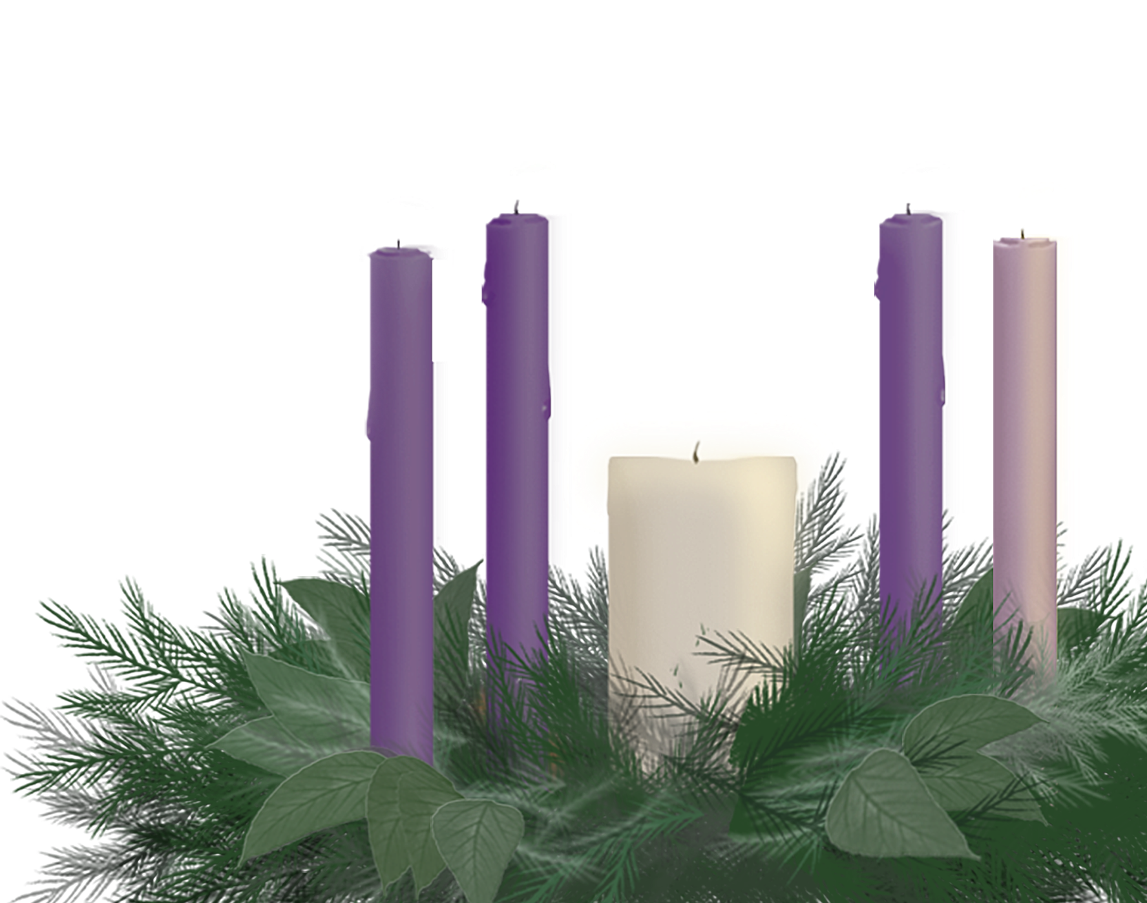
On Christmas Day, the gift God gave to earth,
was an-gels to sing, magi bearing love, shep-herds’ joy,
peace for everyone and the manger
of Bethlehem’s birth!
Notes:
Reader 1:
On Christmas Day, the gift God gave to earth,
was an-gels to sing, magi bearing love, shep-herds’ joy,
peace for everyone and the manger
of Bethlehem’s birth!

Slide 3
We gather around our Advent wreath this morning for a final time. The circle of light will be completed because in its center is the precious gift of the Bethlehem Child.
Notes:
Reader 2:
We gather around our Advent wreath this morning
for a final time. The circle of light will be completed
because in its center is the precious gift of the
Bethlehem Child.

Slide 4
Hope is the first gift.
This candle is lit for the prophets’ hopes of long ago for the Messiah’s birth and the daily hopefulness we experience that turns us to the future with courage.
Notes:
Reader 1:
Hope is the first gift.
This candle is lit for the prophets’ hopes of long ago for the Messiah’s birth and the daily hopefulness we experience that turns us to the future with courage.
Ligher:
Light the Candle of Hope

Slide 5
Peace is the second gift.
Angels sang “Glory to God and Peace of Earth.” Peace makes Christmas real in April or August or October when one small human effort creates harmony in home or community, nation or world.
Notes:
Reader 2:
Peace is the second gift.
Angels sang “Glory to God and Peace of Earth.” Peace makes
Christmas real in April or August or October when one small
human effort creates harmony in home or community, nation
or world.
Ligher:
Light the Candle of Peace

Slide 6
Joy is the third gift.
Joy is spilling out all over—in this sanctuary with all these wonderful faces, but also in faces at the local mall and faces of God’s children all around the world. Joy cannot be contained.
Notes:
Reader 1:
Joy is the third gift.
Joy is spilling out all over—in this sanctuary with all these wonderful faces, but also in faces at the local mall and faces of God’s children all around the world. Joy cannot be contained.
Lighter:
Light the Candle of Joy (a rose candle).

Slide 7
Love is the fourth gift.
Love binds hope and peace and joy together. Love makes a family today of old friends and visitors who’ve traveled as far as modern day magi. Love takes this old story and makes it real in our lives.
Notes:
Reader 2:
Love is the fourth gift.
Love binds hope and peace and joy together. Love makes
a family today of old friends and visitors who’ve traveled as
far as modern day magi. Love takes this old story and makes
it real in our lives.
Lighter:
Light the Candle of Love

Slide 8
Today we light the Christ Candle.
Christ is and always has been the Gift. We prefer to be givers.
It is harder to open our hands and accept this most amazing
present and let
it change our lives.
Notes:
Reader 1:
Today we light the Christ Candle.
Christ is and always has been the Gift. We prefer to be givers. It is harder to open our hands and accept this most amazing present and let it change our lives.
Lighter:
Light the Christ Candle

Slide 9
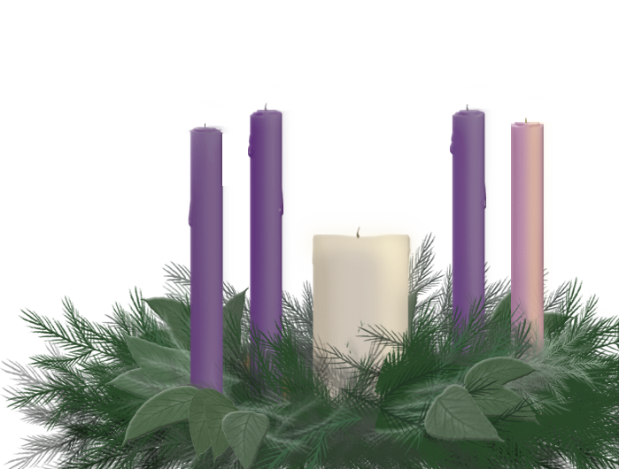
(Let us pray)
On all our days of Christmas the promise we believe is a
blessing we all can receive. Giver of all gifts, today we open our hearts and minds and spirits to you not for this
holy candlelit moment
alone but for
our lives.
Amen.
Notes:
Reader 2:
(Let us pray)
On all our days of Christmas the promise we believe is a
blessing we all can receive. Giver of all gifts, today we open our hearts and minds and spirits to you not for this
holy candlelit moment alone but for
our lives.
Amen.

Slide 10
The annual Christmas Fund sends Christmas gift checks that bring joy to retired members of the pension Fund who are more than one hundred years old.
Notes:
Reader 1:
The annual Christmas Fund sends Christmas gift checks that bring joy to retired members of the pension Fund who are more than one hundred years old.

