Slide 1
Second Sunday
December 9th, 2012

Slide 2
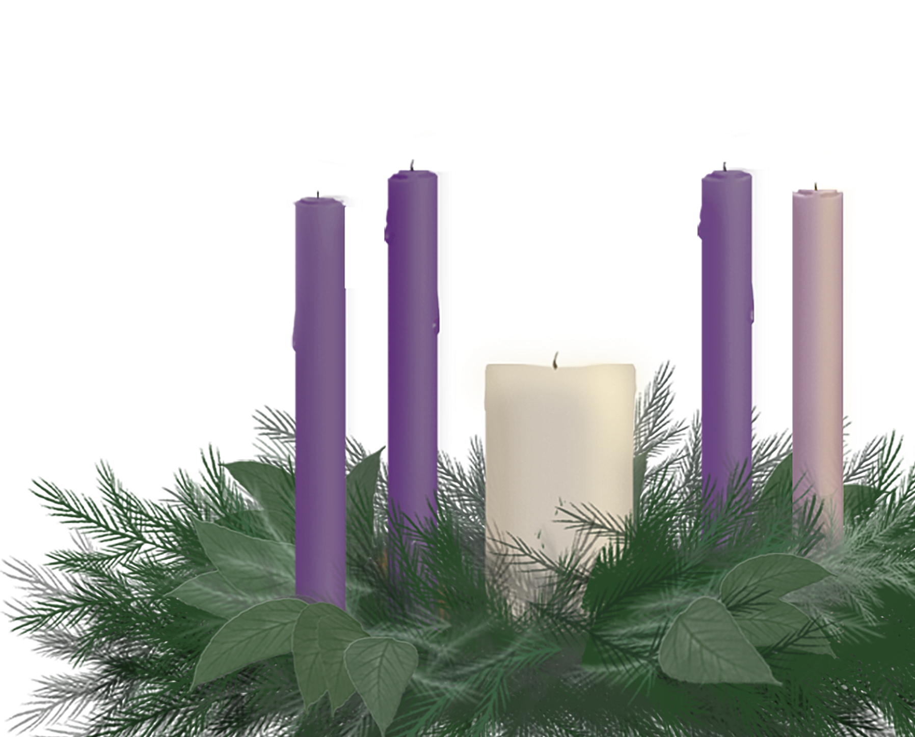
On the second week of Advent the gift God gave to earth – was a dove of peace between us and the hope
of the Bethlehem birth.
Notes:
Reader 1:
On the second week of Advent the gift God gave to earth – was a dove of peace between us and the hope
of the Bethlehem birth.

Slide 3
Light the candle of hope.
Hope makes every gift brighter for hope is “present” before we touch the bow or take off the ribbon.
The Giver of all gifts,
gives Peace.
Light the candle of Peace.
Notes:
Reader 2:
Hope makes every gift brighter for hope is “present” before we touch the bow or take off the ribbon.
Ligher: Light the first candle
The Giver of all gifts,
gives Peace.
Ligher: Light the Second candle

Slide 4
The second gift is peace. God composed an angel chorus of “peace on earth” for the shepherds. An echo is the personal serenity we feel at many moments in Advent, but we’re also aware that we are assigned a “peace of the action” to multiply tolerance, gentleness and caring everywhere we go – from family reconciliation to church or
job conflict resolution, and even to global justice.
The children’s song says
we will be given “two
turtle doves” but we
know God always
provides a whole
flock of understanding.
Notes:
Reader 1:
The second gift is peace. God composed an angel chorus of “peace on earth” for the shepherds. An echo is the personal serenity we feel at many moments in Advent, but we’re also aware that we are assigned a “peace of the action” to multiply tolerance, gentleness and caring everywhere we go – from family reconciliation to church or job conflict resolution, and even to global justice.
The children’s song says we will be given “two
turtle doves” but we know God always
provides a whole flock of understanding.

Slide 5
Giver of all gifts, your second gift is peace, but we need hope in order to open peace up and share it. We thank you for calling us to be peace-makers in everyday December situations like road rage or shopping dysfunction. We have the chance to model reconciliation in family, school, church, workplace, or community.
Help us lift up our harmony as long as there is one hungry child,
one homeless refugee, one soldier far from home, a lonely patient in a hospital or unvisited inmate in a prison.
Someone passed the peace
to us and we want to pass it on.
Amen
Notes:
Reader 2:
Giver of all gifts, your second gift is peace, but we need hope in order to open peace up and share it. We thank you for calling us to be peace-makers in everyday December situations like road rage or shopping dysfunction. We have the chance to model reconciliation in family, school, church, workplace, or community.
Help us lift up our harmony as long as there is one hungry child,
one homeless refugee, one soldier far from home, a lonely patient in a hospital or unvisited inmate in a prison. Someone passed the peace
to us and we want to pass it on.
Amen

Slide 6
(Unison)
Giver of all gifts, thank you for the experiences of peace we have in this season. Your peace is not a Christmas card, an early snow fall, children singing in an Alzheimer’s unit, or the satisfaction of dropping an anonymous bill in the Salvation Army kettle, but all those things do
renew our commitments for ongoing peacemaking on a larger scale. Teach us to pass peace
to others as it has been
passed to us.
Amen.
Notes:
(Unison)
Giver of all gifts, thank you for the experiences
of peace we have in this season. Your peace is not
a Christmas card, an early snow fall, children singing
in an Alzheimer’s unit, or the satisfaction of dropping an
anonymous bill in the Salvation Army kettle, but all those
things do renew our commitments for ongoing peacemaking
on a larger scale.
Teach us to pass peace to others as it has been
passed to us.
Amen.

Slide 7
The annual Christmas Fund gives health supplements that bring peace of mind and spirit to many retired pastors, musicians, sextons and administrators.
Notes:
Reader 1:
The annual Christmas Fund gives health supplements that
bring peace of mind and spirit to many retired pastors,
musicians, sextons and administrators.

