Slide 1

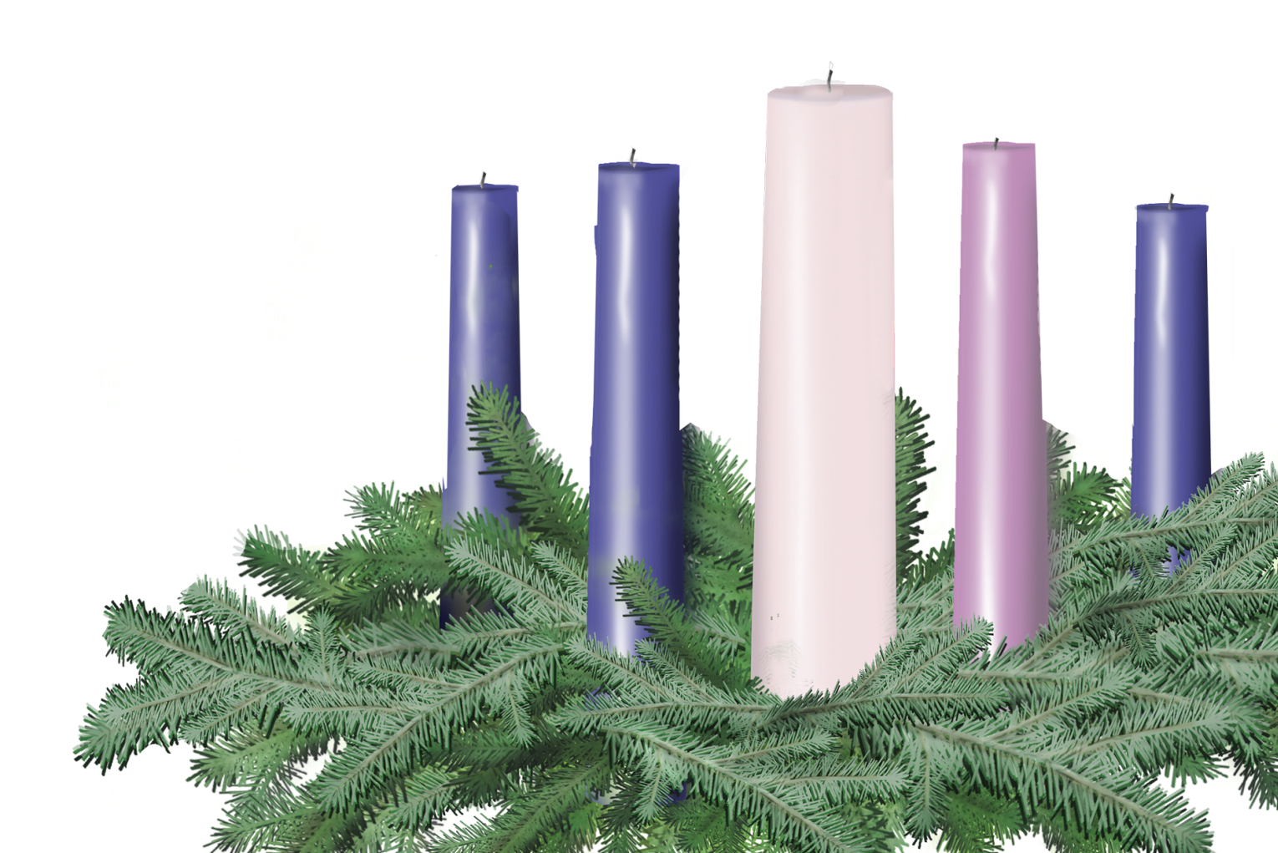



Call to offering
Christmas day

Slide 2
Leader 1:
“They shall beat their swords into plowshares, and their spears into pruning hooks!”
Like Isaiah, they gave us Hope.
“Change your life!” they preached. “God’s Realm is here!”
Like John, they taught us Peace.
ALL:
Leader 2:
ALL:

Slide 3
Leader 1:
“My spirit rejoices in God, my Savior!”
Like Mary, they brought us Joy, even in the darkest places.
When others walked away,
Like Joseph, they stayed with us in Love.
ALL:
Leader 2:
ALL:

Slide 4
Leader 1:
Today we give our money to support our congregation and community as well as a special mission offering of the United Church of Christ called the Christmas Fund.
For over 111 years, the Christmas Fund has been there to be a light of Christ to our United Church of Christ clergy and lay employees who are facing difficult financial situations.
Leader 2:

Slide 5
Leader 1:
The Christmas Fund gives direct support so that retired and active church workers will have quality health care and an adequate monthly income in retirement, as well as emergency assistance when those big burdens come up at any point in life.

Slide 6
ALL:
What we do now is give of our livelihoods, that they might receive that light back.
The offering will now be given and received.
Leader 1:

