Slide 1


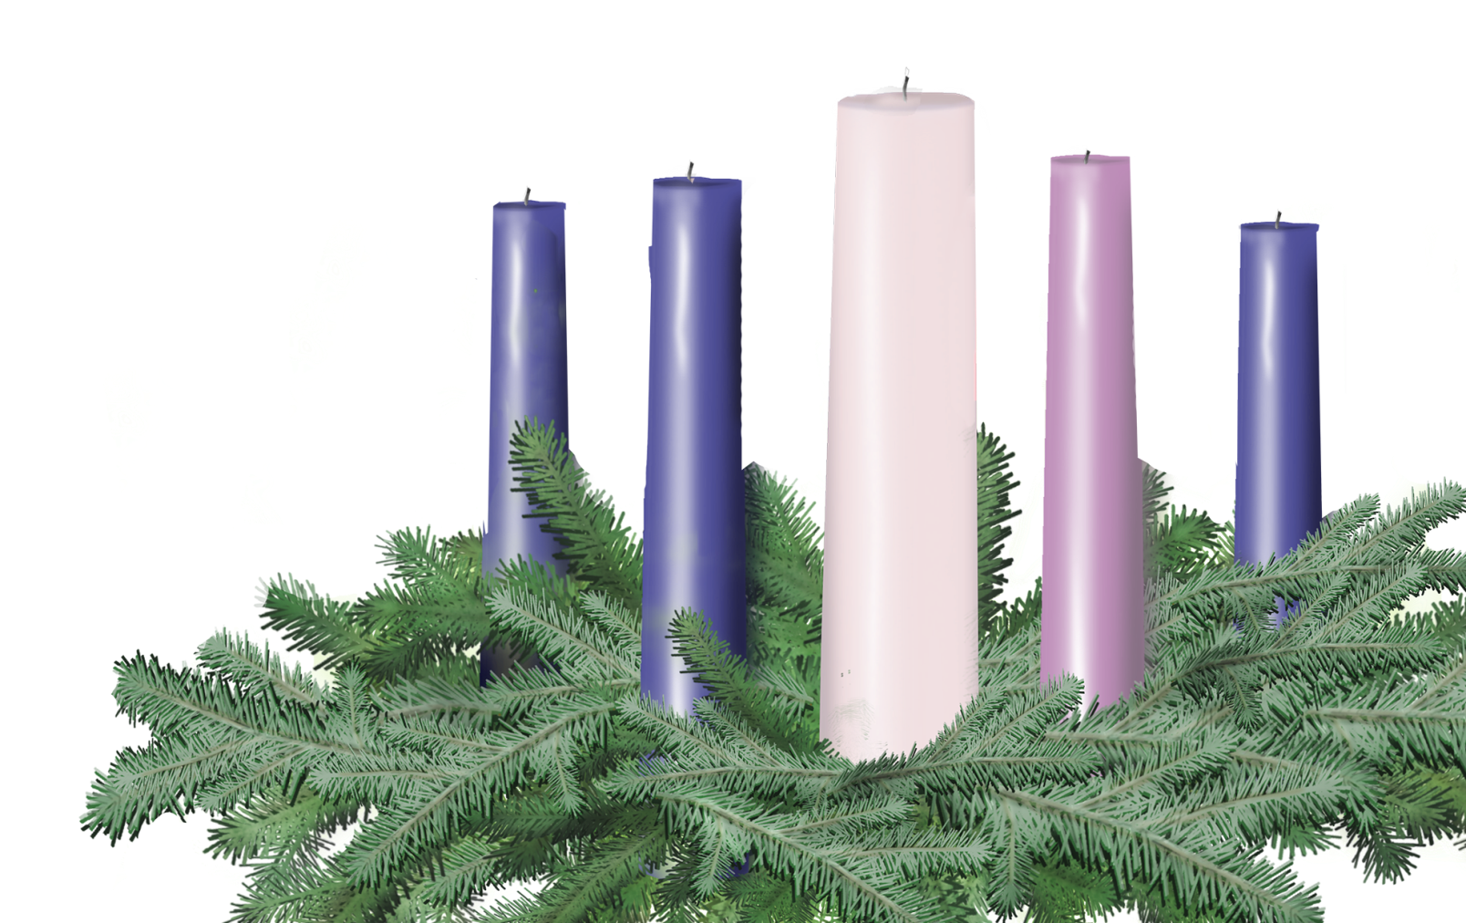
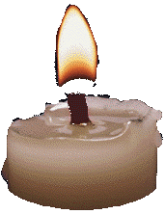
SECOND SUNDAY
IN ADVENT
Sunday, December 8
Multiple Voices
and Congregation
With Reflection
Peace
John the Baptist
– Matthew 3:1-12

Slide 2
Did you know the Christmas story has two Miracle Babies?
Of course the angel Gabriel appeared first to his father, not his mother, and his parents were too old, not too young.
Leader 1:
Leader 2:

Slide 3
But from the time when Mary visited and he started kicking in his mother’s womb, John the Baptist was a sign that Isaiah’s HOPE was happening.
Leader 1:

Slide 4

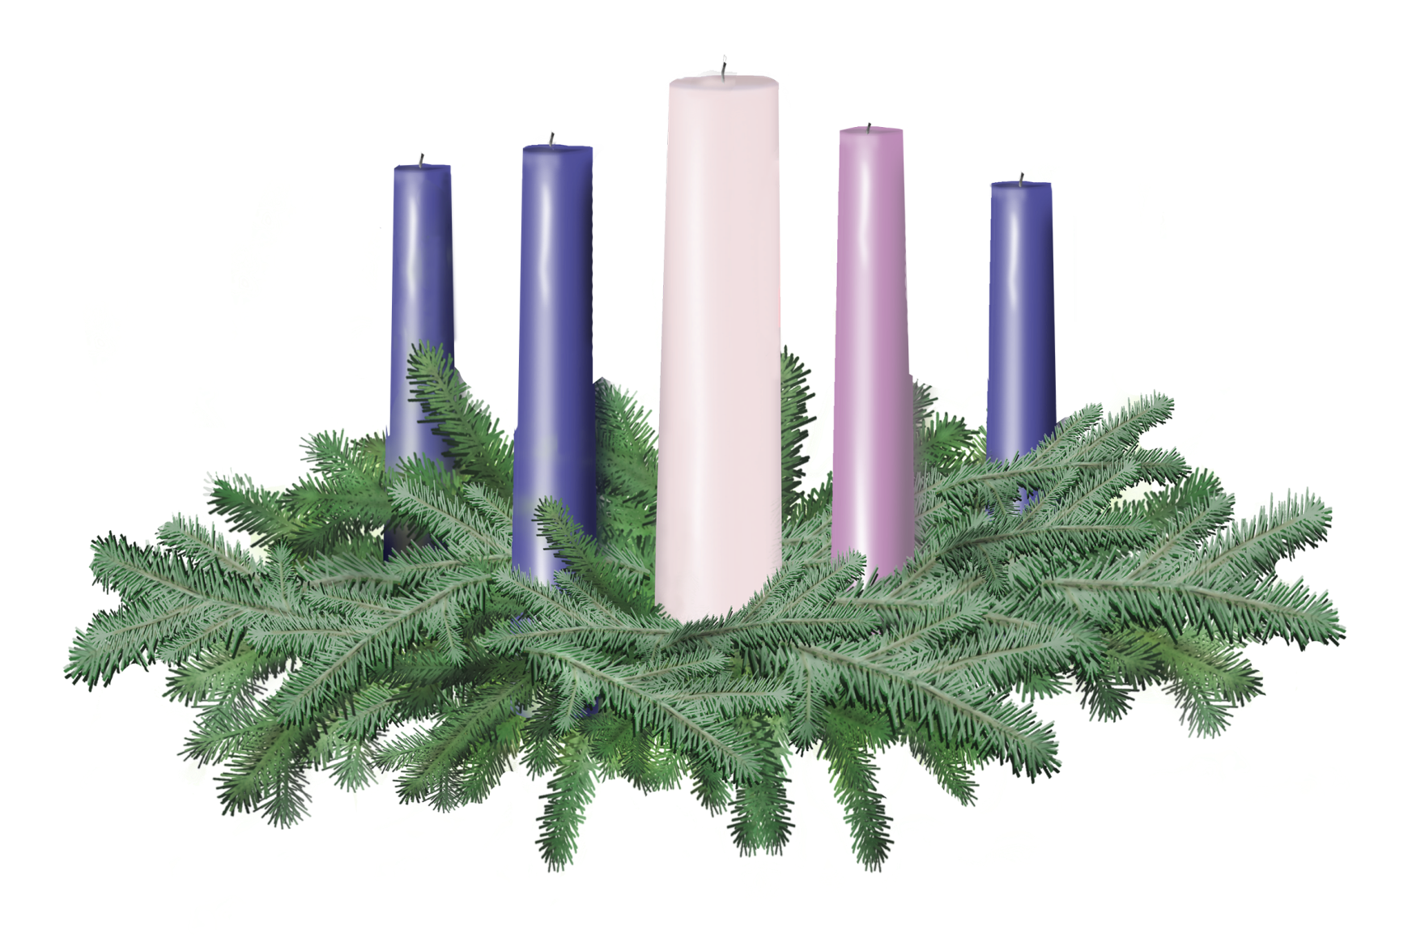
Light the candle of HOPE

Slide 5
Leader 2:
Judea had been conquered by soldiers. The people of John’s day were overworked, underfed, and angry. But John didn’t preach rebellion. He preached metanoia (met-uh-noi-uh) – transformation, conversion, repentance.
“Change your life!” he said. “God’s Realm is here!”
Leader 1:

Slide 6
Leader 2:
And it was. John the Baptist bore the light of God in the darkness because he poured out God’s holy waters of forgiveness, and brought PEACE – one soaking tunic at a time.

Slide 7
Leader 1:
As in the time of John, the world is still dark and in need of peace. Where do you see the need for peace?
(Call out the places in your life and community where you see the need for peace. Examples: We need peace in our relationships; we need peace to illuminate the darkness of poverty.)
All:

Slide 8
Leader 2:
But, like John, we have also seen people working for PEACE. This week, I see peace in (fill in the blank - Examples: our exchange student; in my child’s “big sister” mentor.)
Who has helped you see or experience peace this week?
(Call out the people in your life and community who have helped you see or experience peace.)
All:

Slide 9
Let us pray.
We give thanks for all those who followed the light of Peace - the activists and administrators, mediators and ministers - who lived it and carried it right down through the ages to today. May their lives remind us that we light the candle of PEACE knowing John’s pathway to peace begins right here - with each one of us.
Leader 1:
All:

Slide 10
Light the candle of PEACE

Slide 11
All:
This week, we covenant with you, God, and with each other, to join these peacemakers in spreading the light of Peace beyond these doors. Amen.

