Slide 1


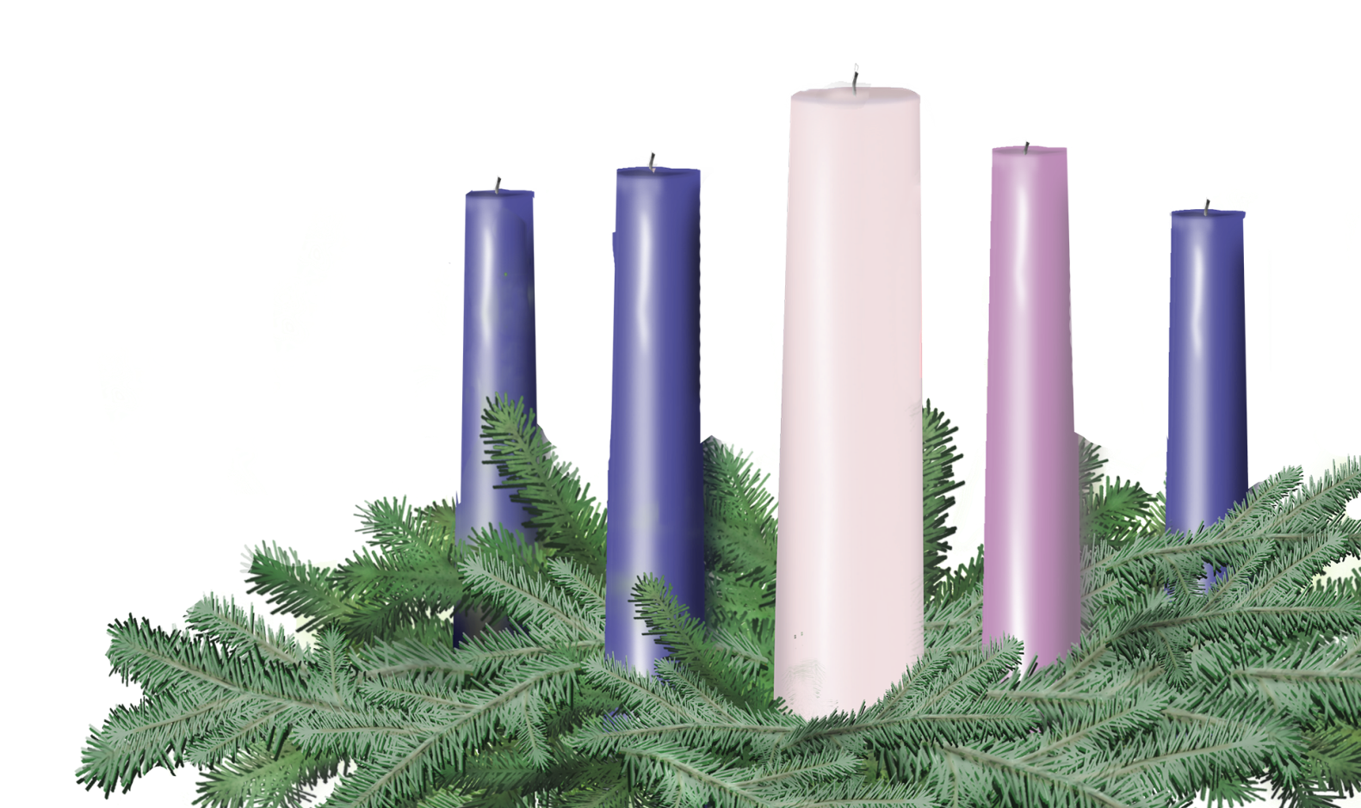

Fourth Sunday in Advent
Sunday, December 21
Leader and Congregation
Psalm 89:1-4, 19-26; Luke 1:26-38

Slide 2
Fourth Sunday in Advent
A lay person or persons may be invited forward to lead the congregation.
One (or Leader)
Before we light the first Advent candle, please join me in a litany of preparation…

Slide 3
One
There is a light drawing near – a light that will soon enter this world in the most unlikely of places, by the most unlikely of mothers.
Many
It is a light that promises hope.
One
It is only a faint glow in the distance, like a new star blooming in the night, but it cannot be contained. It will topple empires, heal the sick, and touch the weary heart.
Many
It is a light that brings peace.

Slide 4
One
The light is a promise, the same promise that the angel Gabriel whispered to Mary so long ago: “Emmanuel,” as if to say, “the Eternal is right here with us.”
Many
It is a light that promises joy.
One
The light is coming, as surely as God’s love is steadfast. Its radiant reach is limitless, enveloping each one of us with a love that knows no bounds.
Many
It is a light that brings us love.

Slide 5
One
Today we light four candles, four small beacons in a sea of shadow. May they be signs for us, shining into our everyday lives with a spark of hope for Monday’s worries, a warm glow of peace for Tuesday’s spats and squabbles, a glimmer of joy for Wednesday’s holiday melancholy, and a love that welcomes, like a brightly-lit doorway, at the weary week’s end.

Slide 6
Lighting the First Four Candles
As the four candles are lit, the congregation may sing “Drawing Nearer” by Christopher Grundy (p. 9 Offering Guide or www.christmasfund.org).
Drawing Nearer
Even in the Midst of all of this
Trouble on the news, no peace within,
Still there is a light in the distance
Drawing nearer, drawing nearer
So, open up our eyes to see your light,
Open up our arms, they’re clenched so tightly,
Come in like a thief and steal our hearts
Like a baby, like a baby.
Even in the midst of all of this.

Slide 7
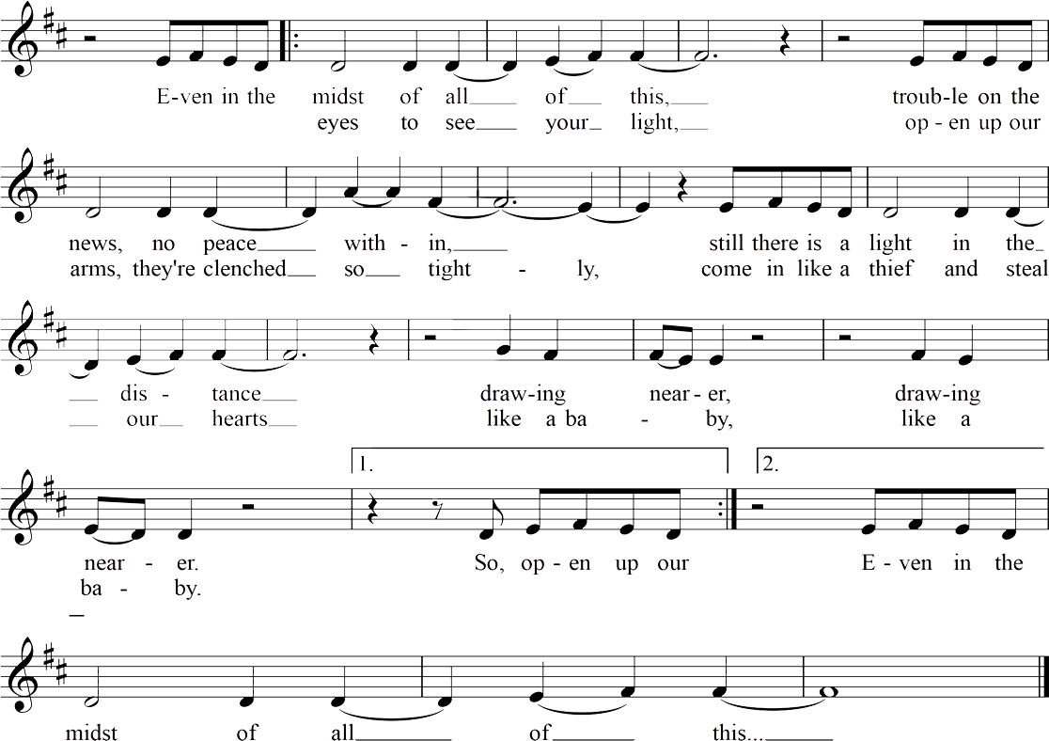
Drawing Nearer
Christopher Grundy

Slide 8

Light the candles of HOPE, PEACE, JOY and LOVE

Slide 9
One
Let us pray.
Many
Gracious God, we give thanks for the light that is dawning, even as the days grow so short. Open us to your nearness, to Gabriel’s good news. Help us to trust, like Mary, that you are actually and truly with us. Help us to say, “Here we are. Let it be with us according to your word.” Breathe upon the spark of your love that is in each of us, until the light and warmth of it can be felt by all those we meet. We pray in the shining name of Jesus. Amen.

Slide 10
One
Please join me in the prayer of dedication.
Many
God of gracious love, we bring before you our gifts and offerings, bringing also our thanks for those leaders of the church who have come before us. Bless these gifts, that through them Jesus’ ministry may go forward, and church leaders in need may know that they continue to be held in your love and care. In Jesus’ name we pray. Amen.

Slide 11


Slide 12
