Slide 1


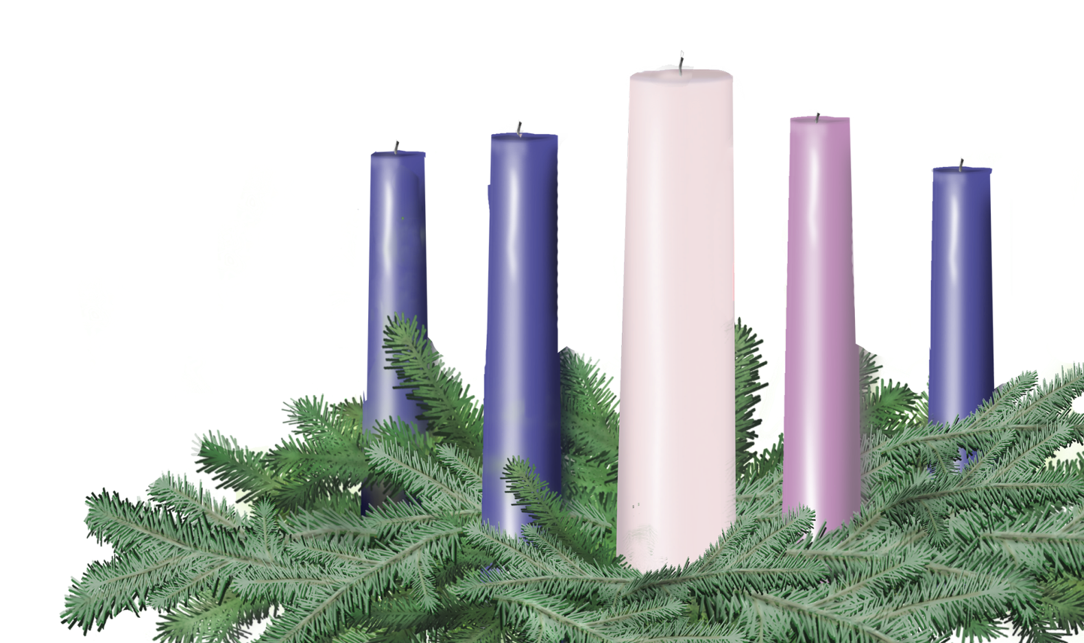

Offering Liturgy for any time of year
Leader and Congregation

Slide 2
One
Will you join me in prayer? Let’s pray together.
Many
God of the ages, God of the saints, we give thanks for all those who have labored together with you for the sake of your realm coming near – and today, especially, those who lead us in your church.
We give thanks also, that we have anything at all to give. Bless what we return to you now. Bless all those who lead your Church as well. Grant them, at the end of their active service, the joy of lives that have meant something, the dignity of a simple life, and a voice that follows them, saying, “Well done, good and faithful servant. “ Amen.

