Slide 1


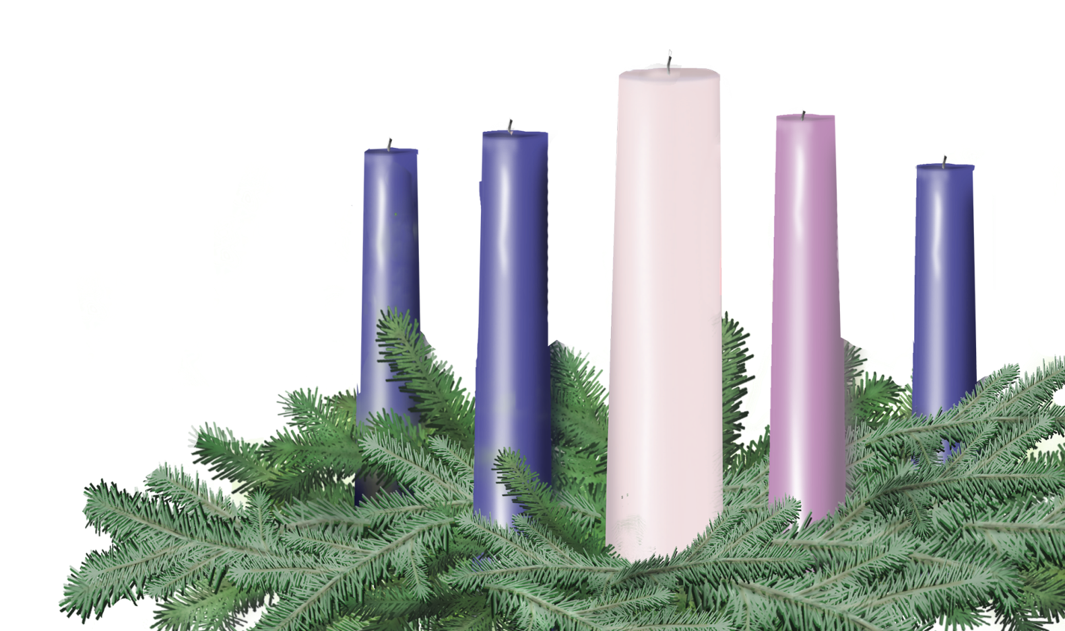

Second Sunday in Advent
Sunday, December 7
Leader and Congregation
Isaiah 40:1-11; Mark 1:1-8

Slide 2
Second Sunday in Advent
A lay person or persons may be invited forward to lead the congregation.
One (or Leader)
Before we light the first Advent candle, please join me in a litany of preparation…

Slide 3
One
Voices cry out from the wilderness:
Many
Prepare the way of the Holy One! Prepare for the glory of God to be revealed, and God’s peace to rise like the dawn among us.
One
This peace may not be easy, if it means that mountains will come crashing down, and rough places will be ground to dust, to make a way.
Many
Yet God once restored Jerusalem,

Slide 4
One
Gathering exiles in his arms, carrying them home in her bosom.
Many
Peace has happened before.
One
Today, on this second Sunday of Advent, we light a candle of
Peace, as a sign of the approaching sunrise, a reminder that we are called to prepare the way for peace:
Many
Making a highway through the desert of the world’s violence, comforting God’s people, speaking tenderly to those who are wounded.

Slide 5
One
And though the way to peace may be hard, peace itself is coming toward us. God comes with might, with an outstretched arm, reaching up, helplessly, from a manager.

Slide 6
Lighting the First Two Candles
As the first and second candles are lit, the congregation may sing “Drawing Nearer” by Christopher Grundy (p. 9 Offering Guide or www.christmasfund.org).
Drawing Nearer
Even in the Midst of all of this
Trouble on the news, no peace within,
Still there is a light in the distance
Drawing nearer, drawing nearer
So, open up our eyes to see your light,
Open up our arms, they’re clenched so tightly,
Come in like a thief and steal our hearts
Like a baby, like a baby.
Even in the midst of all of this.

Slide 7
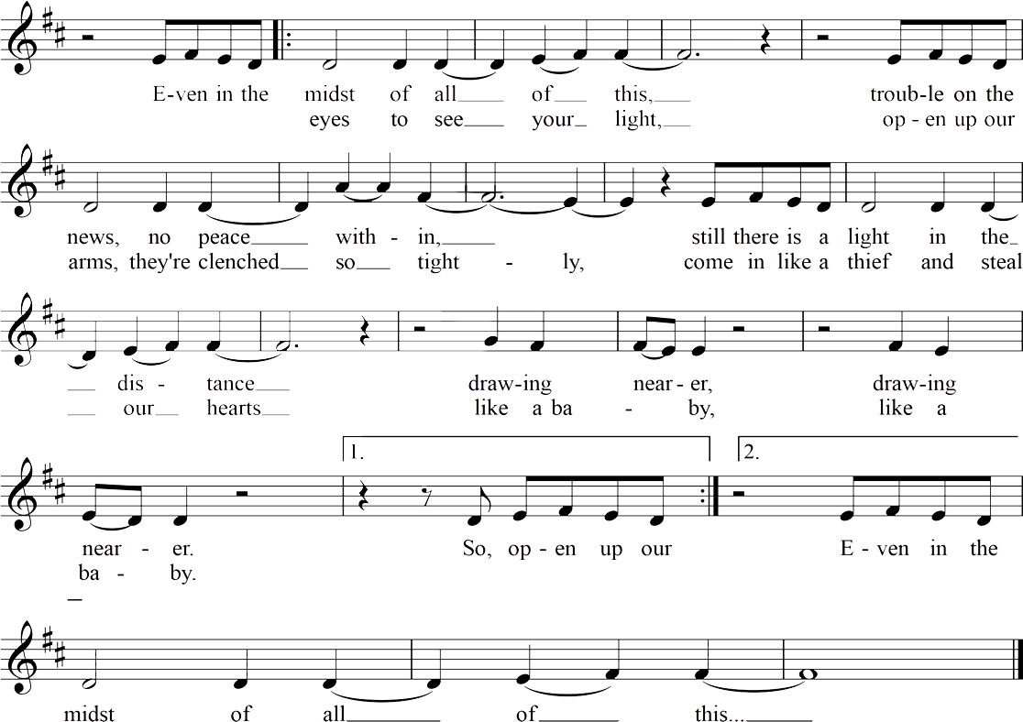
Drawing Nearer
Christopher Grundy

Slide 8

Light the candles of HOPE and PEACE

Slide 9
One
Let us pray together.
Many
Loving God, you provide a mighty peace, even in the midst of trouble. As we light these candles, place your deep peace in us, that we may help to make a way, risking peace each day, for your sake, and the sake of your realm of shalom. We pray this in the name of Jesus, and the Holy Spirit who guides us, Amen.

Slide 10
One
Please join me in a prayer of dedication.
Many
O gracious Giver, accept these our gifts. We have heard your voice speaking peace to us, and now respond, however little or great our resources may be. Bless these gifts, send them forward, that they may help to feed your flock and restore shalom. We seek to be your voice, your hands, your feet. May these gifts be acceptable in your sight, as you are the light of peace for us. Amen.

Slide 11


Slide 12
