Slide 1

FOURTH Sunday in Advent
Sunday, DECEMBER 20th
ADVENT IV – LOVE
Luke 2:1-4

Slide 2
Fourth Sunday in Advent
One:
Elizabeth was barren with no hope for a child, but then a baby filled her womb. The presence of new life filled her with hope.
All :
May the light of Christ fill us with hope.
Light the candle of Hope.

Slide 3
One:
Elizabeth did not know why Mary came rushing through her doors, but the leap of her unborn child filled her with the knowledge of the Lord. The knowledge of the Lord filled her with peace.
All:
May the light of Christ fill us with joy.
Light the candle of Peace.

Slide 4
One:
John the Baptist, while in the womb of his mother, expressed the joy of generations to come. The faith of Mary filled the unborn babe with joy.
All:
May the light of Christ fill us with joy.
Light the candle of Joy.

Slide 5
One:
In a moment filled with hope, in a moment filled with peace, in a moment filled with joy, Mary opens her mouth to sing, “My soul magnifies the Lord, and my spirit rejoices in God my Savior…” Mary rejoices in the God who loves the oppressed; Mary rejoices in the God who loves hungry. Mary a maiden, Mary unseen by the powerful of the world, is filled with the light and made powerful by a God bent on overturning the world with a teenage girl and newborn babe.
All:
Like the first disciple Mary, let the light of Christ fill us with love.
Light the candle of Love.

Slide 6

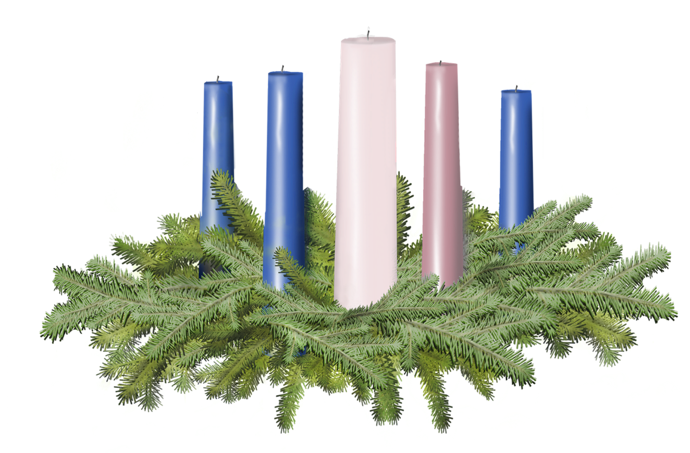

Light the candles of HOPE, PEACE, JOY and LOVE

Slide 7
One:
Please join me in prayer.
All:
God of Love, we thank you for bringing the light of Christ into the world. May the love shared by Elizabeth and Mary serve as a beacon for our own affections. May we, like Mary, create love that exalts the lowly and makes low the proud. May we all bear the light that changes the world. Amen.

Slide 8
Call to Offering
For churches receiving the Christmas Fund Offering today.
One:
Filled with the love and light of Christ, we now take a moment to recognize those ministers and lay employees of the United Church of Christ who work to maintain the love and light we feel. We have all experienced moments in which love and light feel far from our reality. In these moments, we are blessed with ministers and lay employees who take us aside to listen and offer support. The light of their presence helps us to rekindle our own light.

Slide 9
Call to Offering Continued…
Today’s special offering will support the Christmas Fund of the United Church of Christ. The Christmas Fund provides us with an opportunity to assist ministers and lay employees with support during retirement or in the midst of a crisis.
When their wick burns low, we can serve them as they have served us. Please extend your generosity not only to the regular offering, but also to the Christmas Fund. In doing so, we show our love by supporting the current and future Veterans of the Cross.

Slide 10
Prayer of Dedication
One:
Please join me in prayer.
All:
God of Love, we are grateful for these gifts of the congregation. Bless the lives of those who will be served by these gifts, for they have chosen a life of service in your church. May we be blessed by the giving of these gifts, knowing they will help support our Veterans of the Cross as they seek rest in retirement or solace in the midst of a crisis. In the name of the One who died so we may live, Jesus Christ. Amen.

Slide 12
