Slide 1

RESOURCES FOR
ANY TIME OF YEAR

Slide 2
Call to Worship 1
One:
Lift your hearts. Lift your eyes. Lift your eyes. Lift your voices.
All :
The living God, the moving Spirit of God has called us together – in witness, celebration, and struggle.

Slide 3
One:
Reach out toward each other!
All:
Our God reaches out toward us! Come, let us worship God!

Slide 4
Call to Worship 2
One:
Though the way is long and the road is tough,
All :
We do not travel alone.
One:
Though the shadows loom and the wind will rise,
All :
We find strength together.

Slide 5
Call to Worship 2 continued…
One:
Though our feet ache and our muscles strain,
All :
We can make it home only with the help of each other.
One:
We are a pilgrim people.
All :
No one gets left behind.

Slide 6
Call to Worship 2 continued…
One:
and as we travel, may we remember the God who has promised to travel with us.
All :
Come let us sing praises to this God, our companion on the road.

Slide 7
Call to Offering 1
One:
A Veteran of the Cross is a term historically used by the United Church of Christ Christmas Fund to describe clergy and lay employees who have served and are serving the church. Although we may experience our ministers and lay employees as tireless, the truth of the matter is they need rest. Although we may be unaware of the hardships and trials of our ministers and lay employees, unexpected deaths, illness, and disasters regularly occur in their lives.

Slide 8
Call to Offering 1 Continued…
The Christmas Fund provides emergency grants for clergy and lay employees during the unexpected times of financial need. Further, the Fund provides monthly pension supplements to more than 400 lower-income retired UCC clergy.
Christmas “Thank You” Gift Checks are also issued to over 500 retirees. We may not be in the Christmas season, but we can participate in the spirit of the season by giving to the Christmas fund. Today, we have an opportunity to show our gratitude by providing financial support for those who have ministered to us week in and week out.

Slide 9
Prayer of Dedication 1
One:
Let us pray together.
All:
Creator God, we are gathered in this space of worship, which was built with earthly materials and through the spiritual gifts of our Veterans of the Cross. Bless these gifts and be with those who will receive these funds in retirement and in emergency situations. We are thankful for the opportunity to give back to our church leaders, from whom we have received so much. In the name of the son of God, who modeled a life of service, so that we could follow his example, Jesus the Christ. Amen.

Slide 10
Call to Offering 2
One:
We all have our strengths to donate to our community. The authorized ministers and lay employees in the United Church of Christ have donated their time and energy to guide us to spiritual heights and have served us when we were spiritually empty. We receive a Special Mission Offering during this time of year to show our gratitude for all our leaders.

Slide 11
Call to Offering 2 continued…
One:
This Offering helps both active and retired clergy meet basic financial needs like health care and retirement income, and in times of financial strife, the Offering provides emergency assistance. This is our chance to strengthen our community’s commitment to those who serve. Let us receive this morning’s Offering.

Slide 12
Prayer of Dedication 2
One:
Please join me in prayer as we dedicate our gifts.
All:
Gracious God, bestow upon our gifts your great blessing. For those who need them most, may they be the gratitude we wish to show, and may they be the symbols of grace we wish to bear into this world. In giving them, strengthen us through the power of their leadership and work in the Spirit. Amen.

Slide 13
Call to Offering 3
One:
Answering god’s call is rewarding and challenging. Those called to ministry give their time, talents and love continuously, often without anything in return. Today’s Special mission offering will support those who have faithfully served the United church of Christ and it’s mission. Today’s offing will assist authorized ministers and lay employees with support during retirement, during times of crisis, and in subsidizing health care costs. Let us give as they have given, freely and generously, without expectations of what can be gained.

Slide 14
Prayer of Dedication 3
All:
Generous God, we ask that you use these gifts to support those who have so generously supported us. May they be a token of our appreciation for their countless hours of service and dedication to you and your work. We ask this in the name of Jesus Christ, whose path we long to follow. Amen.

Slide 15

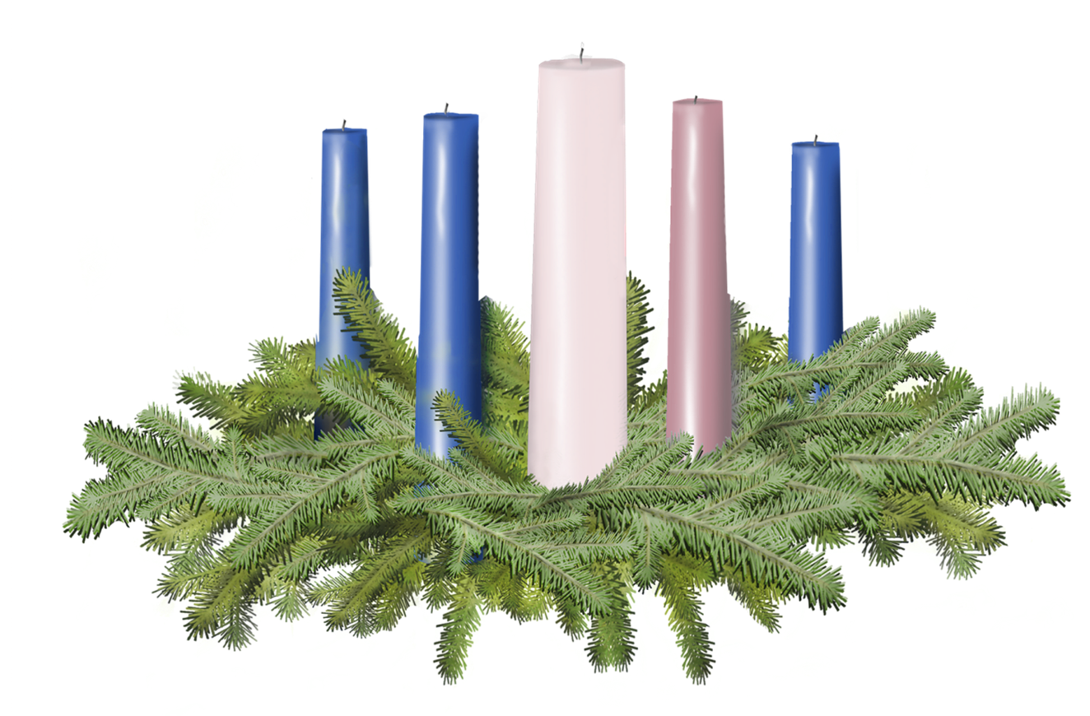


Slide 16
