Slide 1

SECOND Sunday in Advent
Sunday, DECEMBER 6th
ADVENT II – PEACE
Luke 3: 1-6

Slide 2
Second Sunday in Advent
One:
We light this candle of peace,
All :
Reflecting on the proclamation of John the Baptist more than 2,000 years ago and working to spread the good news today.

Slide 3
One:
We light this candle of peace,
All:
Working toward and crying out for a world where everyone’s basic needs are met.
One:
We light this candle of peace,
All:
Smoothing the rough ways and making paths in order to end discrimination and persecution.

Slide 4
One:
We light this candle of peace,
All:
Awaiting the arrival of Jesus Christ, light of the world. There is darkness everywhere. Be the light.
Light the candles of Hope and Peace.

Slide 5

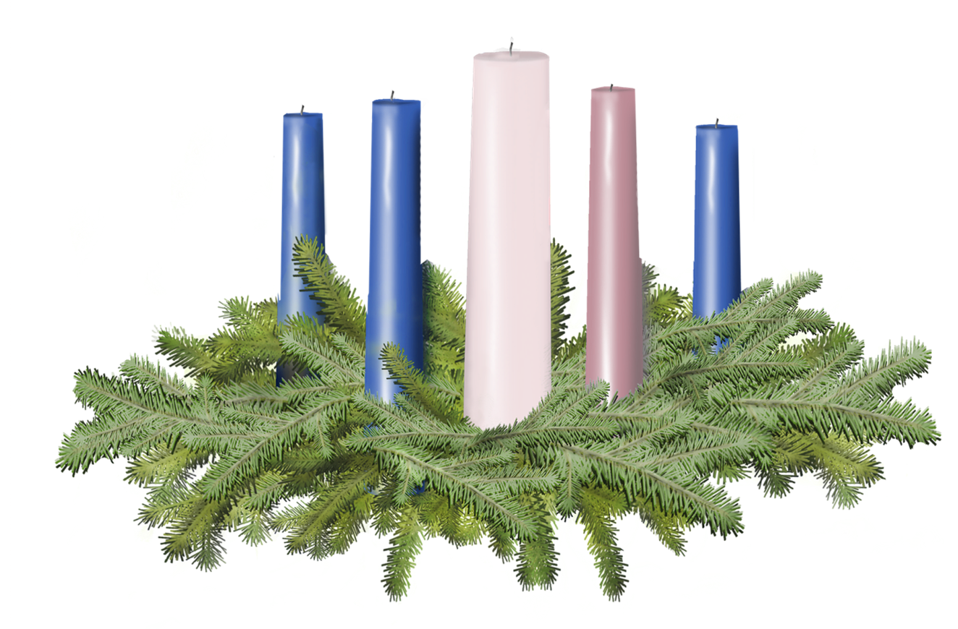

Light the candles of HOPE and PEACE

Slide 6
Call to Offering
For churches receiving the Christmas Fund Offering today.
One:
Presents and gifts are often on our minds during the Season of Advent. As we prepare to give our gifts this morning, let us take a moment to remember the many gifts that have been bestowed upon us. Gifts of love, time, education; gifts from our parents, our teachers, our pastors; gifts from God. During this season of Advent, our special offering will be used to support the Christmas Fund of the United Church of Christ.

Slide 7
Call to Offering Continued…
Our special offering this morning will benefit active and retired pastors and lay employees with health care, retirement income, and relief from financial emergency. Let us give graciously, in celebration of the gifts we receive and in anticipation of the gift of God’s son.

Slide 8
Prayer of Dedication
One:
Will you please join me in prayer:
All:
Gracious Giver, bless these gifts that are present before you. May they be used to provide for those who have given to us. Use them, we pray, that they may help your light continue to shine in a world that can often seem dark. We ask you think, in the name of your greatest gift, Jesus Christ, the Prince of Peace. Amen.

Slide 10
