Slide 1

THIRD Sunday in Advent
Sunday, DECEMBER 13th
ADVENT III – JOY
Luke 2:1-14

Slide 2
Third Sunday in Advent
One:
This morning, hear anew the Baptizer’s prophetic announcement of the coming of the Messiah and interpret it wisely.
All :
We need not shrink from the challenge of repentance because when we’ve been truly rearranged on the inside, we will bear good fruit on the outside.

Slide 3
One:
During these troubling times in our nation and around the world , the question from the crowds still persists, “What then should we do?”
All:
Once again we humbly dedicate ourselves to kindness, to justice, and to fairness.

Slide 4
One:
On this third Sunday of Advent, we light a candle of joy, as a visible symbol of these “fruits worthy of repentance.”
All:
Come let us be baptized with winds of the Spirit and refined by the fire of God’s word.
Light the candles of Hope, Peace and Joy.

Slide 5

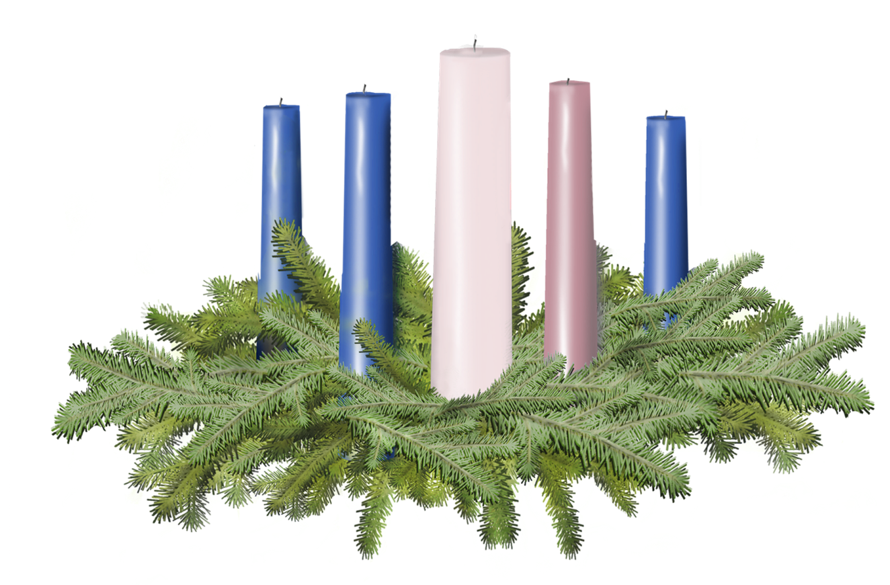

Light the candle of HOPE, PEACE and JOY

Slide 6
One:
Let us, though many, pray in one voice.
All:
Gracious and loving God, as we await the coming of the One whom you sent, grant that our waiting might be the active kind. Give us the courage to meet the challenge of altering our thoughts and feelings about the world around us so that our actions might also be changed. Help us to keep our priorities straight, our passions properly pointed, and our eyes fixed upon the prize of joy. Remind us that you lovingly require evidence of our repentance – kindness, justice and fairness. We pray in the name of Jesus Christ. Amen.

Slide 7
Call to Offering
For churches receiving the Christmas Fund Offering today.
One:
Giving can be seen as a privilege rather than a problem, especially when we do so under the influence of joy. Mother Teresa described joy as a net of love by which souls may be caught. During the Advent season, in addition to our regular offering, we embrace a unique giving opportunity; a Special Mission Offering of the United Church of Christ called the Christmas Fund. This offering celebrates clergy and lay leaders who have shared their gifts and cast their nets on behalf of the Church of Jesus Christ.

Slide 8
Call to Offering Continued…
This offering benefits active and retired pastors and lay employees with health care, retirement income, and relief from financial emergency. The Christmas Fund Offering represents a moment when we return a portion of the love we have received to those who have first loved and served us. Let us pour out our joy even as we are filled with expectation for the coming Messiah.

Slide 9
Prayer of Dedication
One:
Please join me in prayer.
All:
God of justice and joy, we make this special offering knowing that it is acceptable not only because there are those who need our gifts, but also because you have called us to be givers. Bless these donations and multiply them by your Holy Spirit so that they may bring assurance of your provision and grace to those who have faithfully served the untied Church of Christ. In Jesus’ name we pray. Amen

Slide 11
