Slide 1
FIRST SUNDAY IN ADVENT HOPE Isaiah 2:1-5; Matthew 24:36-44

Slide 2
Lighting the First Advent Candle
One:
God of justice and of peace – You color the world with mercy and kindness
Many:
We stand in awe and wonder before your marvelous artistry

Slide 3
One:
God of promise and of love – You illuminate the skies with rainbow and sun-ray.
Many:
We rejoice in the majesty of your creation.
One:
The spectrum of your love reveals light all around. The hues of your love warm our spirits. The vibrancy of your love saturates us with hope. All:
Blessed is the God of love whose art expressed in Christ we anticipate

Slide 4
One:
We light this candle in abundant hope that the radiance of you, O God, Will shine in our hearts, coloring us with hope, As we anticipate the coming of Jesus Christ.
Many:
Amen.

Slide 5
Light the Candle of Hope
The candle is lit, the congregation sings
All: Shine a candle in the darkness, breathe new hope into our lives. Wind your blessed peace around us till the day when Christ arrives. Shine a candle in the darkness. Wind your blessed peace around us. Shine a candle in the darkness, breathe new hope into our lives. Wind your blessed peace around us till the day when Christ arrives.

Slide 6
Call to Offering
For churches receiving the Christmas Fund Offering November 27.
Imagine now a master painter, preparing to create a work of art. We see the blank canvas. A handful of brushes. A palette of vivid colors. But what we do not see – what we cannot see – is that which will bring the art to live: hope. Hope is what allows the painter to imagine what the face of the blank canvas can become. Call it vision or insight, hope guides the artist’s heart and hand in creating art that can be seen and experienced.
Continued . . .

Slide 7
We too have access to this type of creative expression. Armed with hope, we dab our brushes into the infinite spectrum of colors:
… the vibrant hues of generosity
…the brilliant shades of kindness
…the warm color of love
And we create.
The result Is a type of art that breathes generosity and kindness and peace into the world. By giving to the Christmas Fund of the United Church of Christ, we have a chance to express not only hope for the church but also gratitude for those master painters among us who with hope have created such beautiful expressions of love through their ministries. May our offering reflect sincere gratitude in its giving.

Slide 8
Prayer of Dedication
All:
Holy God, we pray for the peace of those who have served you.
May they prosper who love you. Grant them peace and security.
In the name of all that is Holy, we ask your blessing on these gifts given today.
We ask that you reward our hope and magnify these gifts in ways that bring glory and honor to you and relief and security to those who have served you and your church.
Bless our broad brushstrokes selected from the palette of your great love so that the art in us illustrates your unending kindness and grace.

Slide 9
All: Continued
Oh, God, we yearn for your coming, and wait with hope.
In the meantime, may we be found being generous, performing acts of justice, and living honorably, Awaken us to your coming. And awaken us to an even greater spirit of generosity and of hope. Amen.

Slide 10
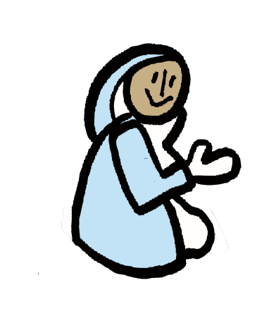
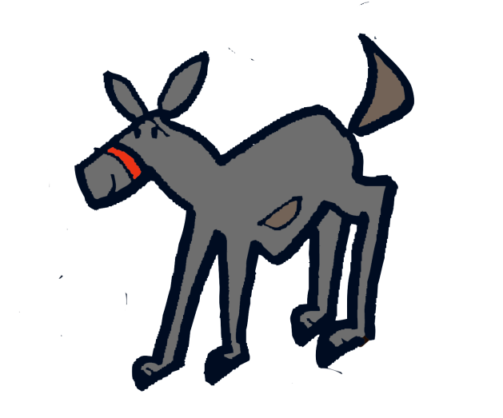
All: Continued
Oh, God, we yearn for your coming, and wait with hope.
In the meantime, may we be found being generous, performing acts of justice, and living honorably, Awaken us to your coming. And awaken us to an even greater spirit of generosity and of hope. Amen.

