Slide 1
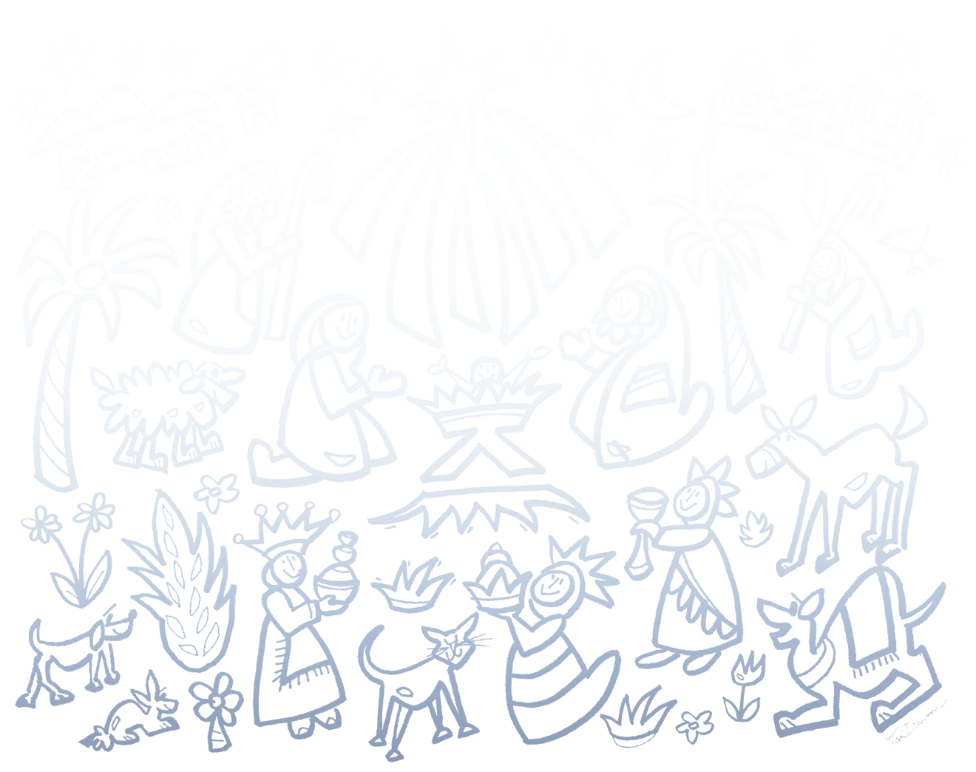

RESOURCES FOR ANY TIME
OF YEAR 2

Slide 2
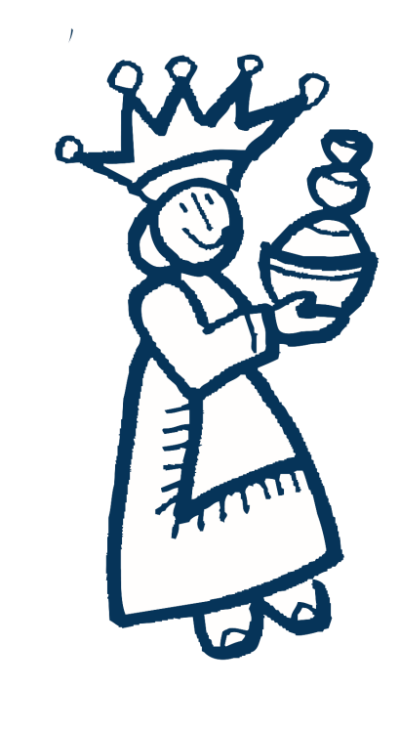
Call to Worship
One:
We gather for worship giving thanks for the faithful witness of our forbearers. For reformers.
Elders:
who challenged injustice and sought integrity.
One:
For saints
Adults:
who embodied grace and offered examples of faithful living.

Slide 3
One:
For servants
Youth:
whose words and beliefs were matched by actions of justice and mercy.
One:
For leaders
Children:
who reached out with love and open hearts.
One: With the whole cloud of witnesses to your love and grace, we join together in prayer and praise.
All: Let us worship God, who forms us into a communion of saints and sinners, and servants, lovers and leaders, dreamers and doers.

Slide 4


Call to Offering
We are used to giving gifts at Christmas time, for birthdays, for celebrations, and special occasions. These significant moments we mark by sharing something of what we have with those we love to honor, bless, and thank them. But our Christian faith tells us that giving gifts is something we are called to do all year round, and not only to people we know and love, but to those who are strangers, and even our enemies, out of gratitude to God for God’s abundant grace.

Slide 5

Call to Offering, Continued
This kind of giving is what we practice in our offerings each week, a spiritual practice of gratitude. And this week we have the opportunity to honor, bless, and thank those Veterans of the Cross who have been ministers and lay employees through our contributions to the Christmas Fund of the United church of Christ. Every moment is an opportunity to give. Let us seize this moment, in gratitude and praise.

Slide 6
Prayer of Dedication
One:
For all that we are blessed to give, Holy One, we say:
All:
Thanks be to you, Creator.
One:
For all that we have received, Holy One, we say:
All:
Praise be to you, Redeemer.

Slide 7
One:
For all your servants, Holy One, we say
All:
Glory be to you, Sustainer.
One:
For all that we are called to do and be, holy One, we say:
All:
Blessed be the One God, Creator, Christ, and Spirit, now and forever. Amen

